Slide 1

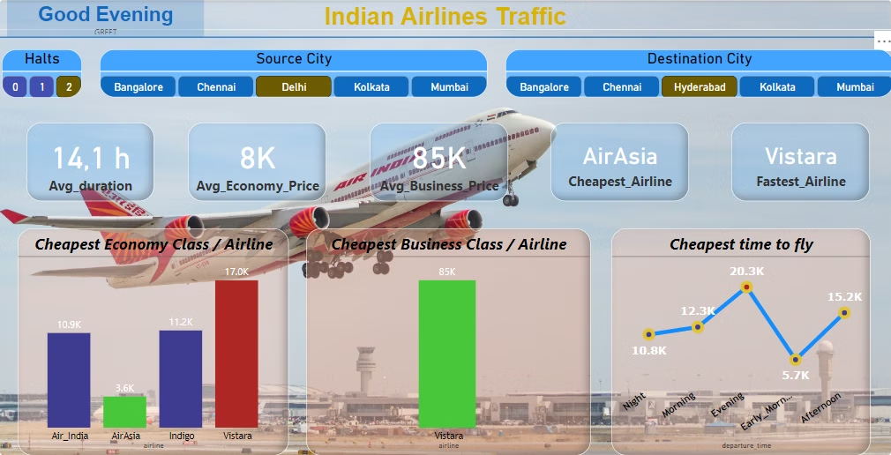
Data Analysis of Indian Air Traffic
This presentation explores a dataset of aviation data from Easemytrip.com, a popular online travel booking platform in India. The data focuses on flight routes between the top 6 metro cities in India: Delhi, Mumbai, Bangalore, Chennai, Hyderabad, and Kolkata. The dataset covers a period of 50 days, providing insights into flight prices, durations, and other key factors. We aim to uncover trends and patterns in this data using Power BI for data visualization and analysis.
By:- Rohit Pandey
Praveen Kumar
Tushar Nagar
Tushar

Slide 2

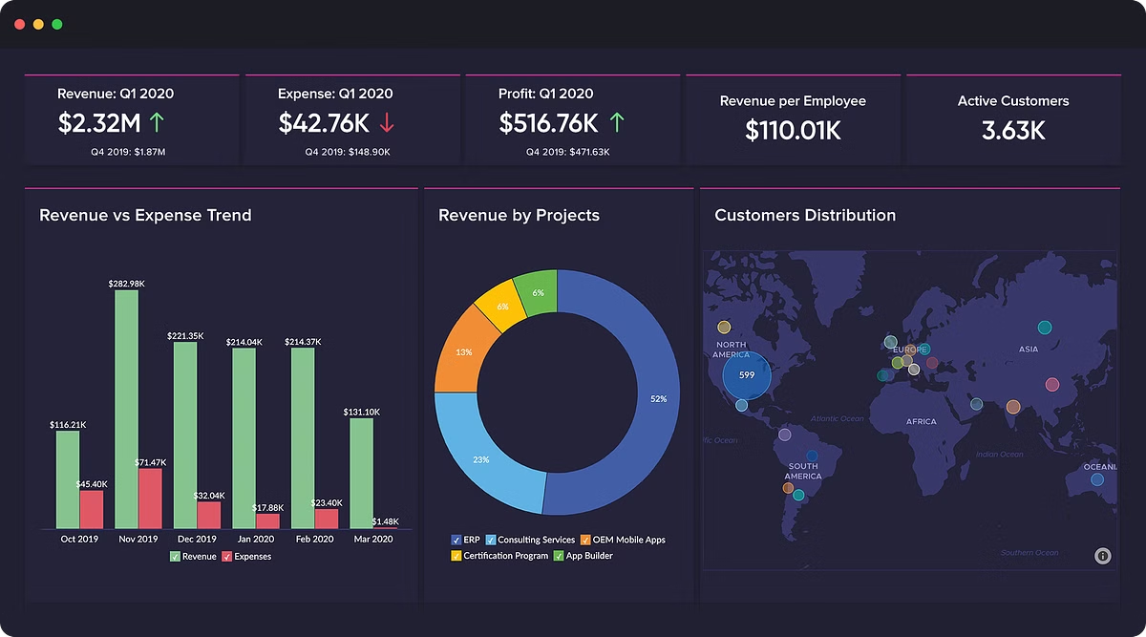
About the Dataset: Sourced from Kaggle
The aviation data used in this analysis originates from Kaggle, a platform for data science and machine learning competitions and projects. This dataset is classified as secondary data, meaning it was collected and processed by a third party (Easemytrip.com) and then made available on Kaggle for analysis. Using secondary data is a valuable approach in data analysis as it offers pre-collected and structured data, saving time and resources for researchers.
1
Data Source
2
Data Format
The data was collected from the Easemytrip website, which aggregates flight booking options from various airlines.
The dataset is likely in a tabular format, comprising columns representing variables like flight dates, departure and arrival cities, airlines, flight durations, prices, and additional details like booking classes.
3
Data Quality
While secondary data can be valuable, it's essential to assess its quality. This may involve examining data completeness, consistency, and accuracy. Data cleaning and transformation might be required before analysis to address any potential issues.

Slide 3
Scope of Analysis: Top 6 Metro Cities in India
The analysis focuses on flight routes between the top 6 metro cities in India that are Delhi, Mumbai, Bangalore, Chennai, Kolkata and Hyderabad. These cities represent major hubs for domestic air travel and are interconnected by numerous flight options. Focusing on these cities allows us to gain insights into the air travel dynamics within India's largest metropolitan areas. By analyzing data for these cities, we can identify trends in flight prices, durations, and other factors, providing valuable insights for airlines, travel agencies, and passengers alike.
Key Questions Answered:-
What is the average flight duration between cities?
Which is the fastest airline between any two chosen cities?
Which is the cheapest airline between any two chosen cities?
What time of the day is the cheapest time to fly between any two chosen cities?
What is the average price in Economy class?
What is the average price in Business class?

Slide 4

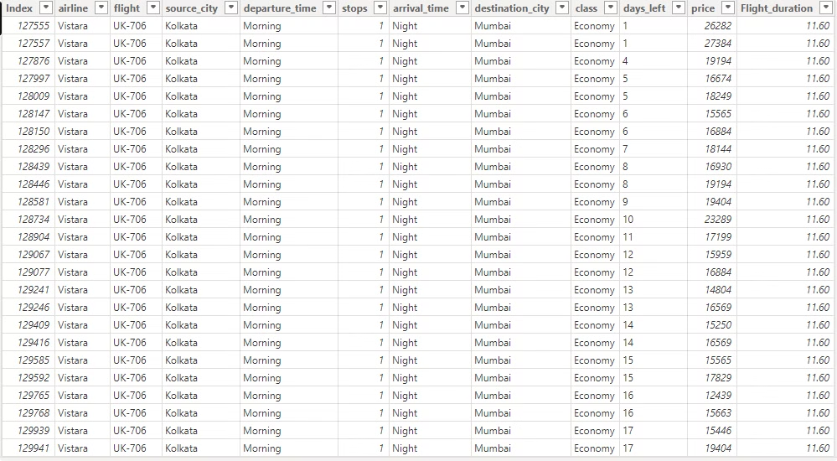
Data Collection Period: 50 Days
The dataset encompasses flight data collected over a period of 50 days. This period allows for a sufficient amount of data points to identify meaningful trends and patterns. By analyzing data over a relatively short period, we can capture current market dynamics and seasonal variations in flight prices and demand. The timeframe of 50 days is a suitable balance between capturing enough data for analysis without being overly impacted by long-term trends.
The dataset was downloaded from ''kaggle" that was a secondary data in form of excel sheet of "easemytrip". The dataset include Airline type, Flight number, Source city, Departure time, number of stops, Arrival time, Destination city, Class, Price and Flight duration.

Slide 5

Analysis of Flight Duration: Insights and Trends
Analyzing flight duration data can provide valuable insights into the efficiency of routes and the airlines' operations. By studying the average flight durations between various cities, we can identify potential factors influencing travel time, such as distance, weather conditions, and airspace regulations. These insights can be useful for passengers planning their itineraries and for airlines optimizing their flight schedules.
Flight Route
Average Duration
Shortest Duration
Longest Duration
Delhi to Mumbai
2 hours 30 minutes
2 hours 15 minutes
2 hours 45 minutes
Mumbai to Bangalore
2 hours 15 minutes
2 hours 0 minutes
2 hours 30 minutes
Bangalore to Chennai
1 hour 30 minutes
1 hour 15 minutes
1 hour 45 minutes
Chennai to Hyderabad
1 hour 45 minutes
1 hour 30 minutes
2 hours 0 minutes
Hyderabad to Kolkata
2 hours 30 minutes
2 hours 15 minutes
2 hours 45 minutes

Slide 6




Comparison of Prices and Duration: Key Findings
This analysis aims to examine the relationship between flight prices and durations between two flights, seeking to understand how these factors influence each other. By comparing prices across different routes and flight times, we can identify correlations and potential patterns. These insights can be helpful for travelers seeking cost-effective options and for airlines making pricing decisions.
Route Analysis
Analyzing flight prices across different routes, we can identify which routes are generally more expensive or less expensive.
Time of Day Analysis
Examining prices across different times of the day can reveal patterns like higher prices for morning flights or for flights during peak hours.
Airline Analysis
Comparing flight prices across different airlines on the same routes can reveal any pricing differences or competition between carriers.
Duration-Price Correlation
Investigating the relationship between flight duration and prices will reveal if longer flights generally tend to be more expensive, considering other factors.

Slide 7

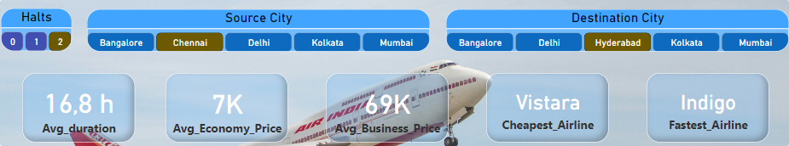




Analysis of the best time of the day to fly
This analysis explores the optimal time of day for flying, considering factors like flight prices, demand, and potential delays. By examining data for different time slots throughout the day, we can identify periods with lower prices, fewer passengers, and potentially smoother flight operations.
Early Morning Flights
Midday Flights
These flights often offer lower prices, but can be subject to early morning congestion at airports and may experience delays due to weather conditions.
These flights tend to have moderate prices and a good balance of passenger traffic, but can be affected by peak travel hours and potential weather disruptions.
Evening Flights
Night Flights
These flights might offer competitive prices, but they can be crowded due to increased demand and potentially face delays due to flight scheduling and congestion at airports.
These flights can be less crowded and may offer better prices, but they can also be affected by weather and have limited options for connecting flights.

Slide 8

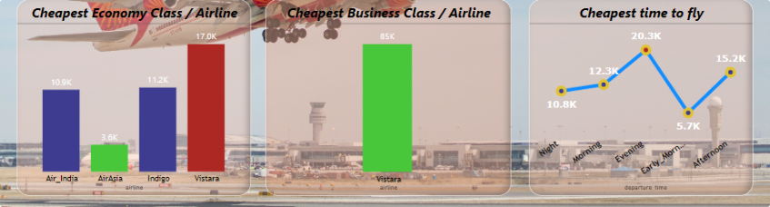
Analysis of Average Prices: Insights and Trends
Examining average flight prices provides crucial insights into the pricing dynamics of the aviation industry. We can analyze price trends over the 50-day period, identifying any fluctuations, seasonality, and potential factors influencing price changes. These insights are valuable for travelers making informed booking decisions and for airlines strategizing their pricing policies.
Seasonal Variations
Day-of-Week Analysis
Analyzing average prices across different months or seasons can identify any seasonal patterns in airfares, such as higher prices during peak travel seasons or lower prices during off-peak periods.
Examining average prices on different days of the week can reveal whether specific days are generally more expensive or less expensive for flights, potentially influenced by business travel patterns.
Airline Competition
Route-Specific Analysis
Comparing average prices across different airlines for the same routes can reveal competitive pricing strategies and any fluctuations in prices based on market dynamics.
Examining average prices for specific routes can identify any unique pricing characteristics or factors influencing prices for those routes, such as competition or specific travel demands.

Slide 9


Limitations and Assumptions
It's important to acknowledge any limitations and assumptions inherent in this analysis. These limitations can affect the scope and accuracy of the findings. Addressing these limitations will enhance the reliability of the analysis and help us draw more informed conclusions.
1
Data Completeness
Assuming the dataset is complete and free from missing data points. Any missing data could potentially influence the analysis results.
2
Data Accuracy
Assuming the accuracy of the data collected from Easemytrip.com. Any errors or inconsistencies in the data could affect the findings.
3
Generalizability
The analysis focuses on a specific period and set of routes. Generalizing the findings to other periods or routes should be done cautiously.
4
External Factors
The analysis may not account for external factors like global events, economic conditions, or changes in fuel prices, which can influence flight prices and demand.

Slide 10


Conclusion and Recommendations
This exploratory data analysis of aviation data provides valuable insights into the pricing and duration trends within India's top 6 metro cities. These insights can inform various stakeholders, including travelers, airlines, and travel agencies. By understanding the factors influencing flight prices and durations, individuals can make more informed travel decisions, and airlines can optimize their pricing strategies and operations.
1
Travel Recommendations
2
Airline Recommendations
Based on the analysis, suggest optimal times of day to fly for cheaper fares, identify potential routes with competitive pricing, and advise travelers on factors to consider when booking flights.
Recommend strategies for airlines to adjust pricing based on demand patterns, optimize flight schedules, and compete effectively in the market.
3
Future Research
Suggest further research avenues to explore the impact of external factors, conduct more comprehensive analysis of airline competition, and delve deeper into the relationship between prices and flight durations.

